Slide 1



Department of Public Works & Transportation
Childcare Facility
Leonardtown Planning Commission
5/20/2024

Slide 2
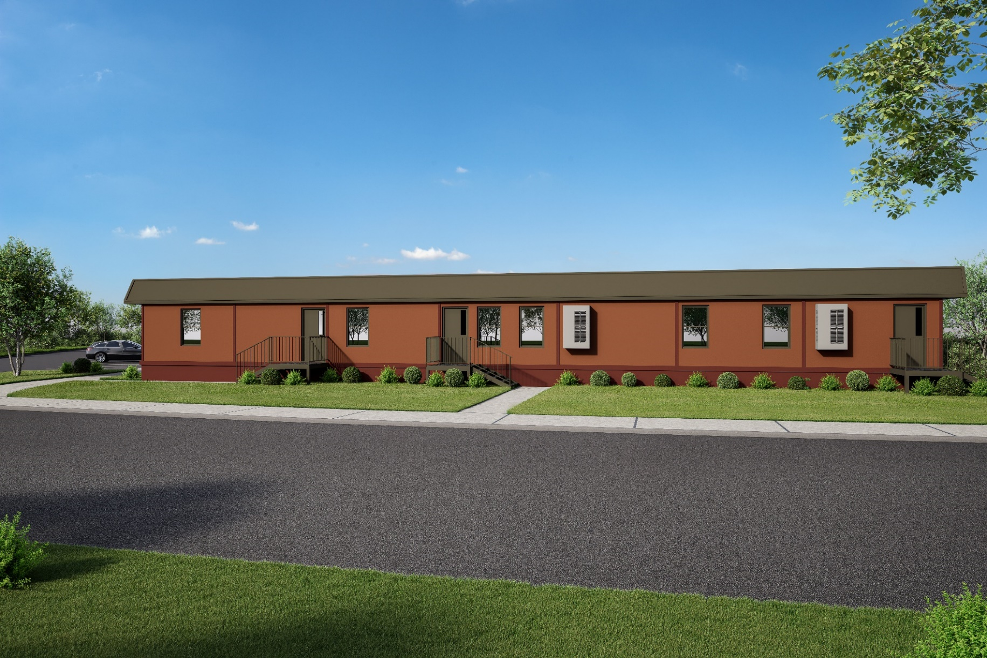
Childcare Facility
Located at the Governmental Center

Slide 3
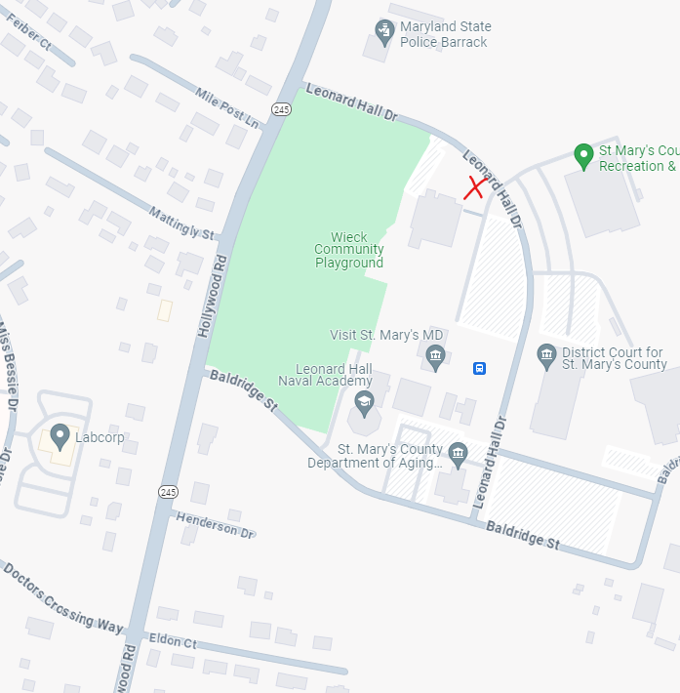
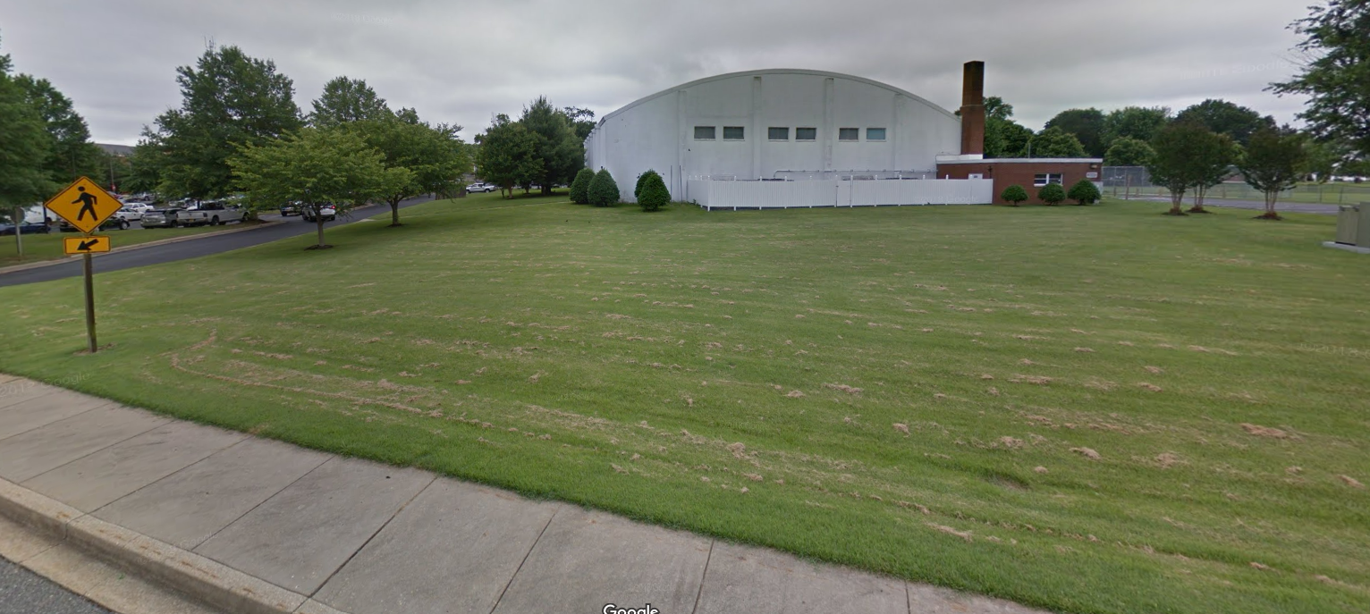
Vicinity
Beside Leonard Hall Recreation Center

Slide 4
Site Plan
Located at the Governmental Center

Slide 5
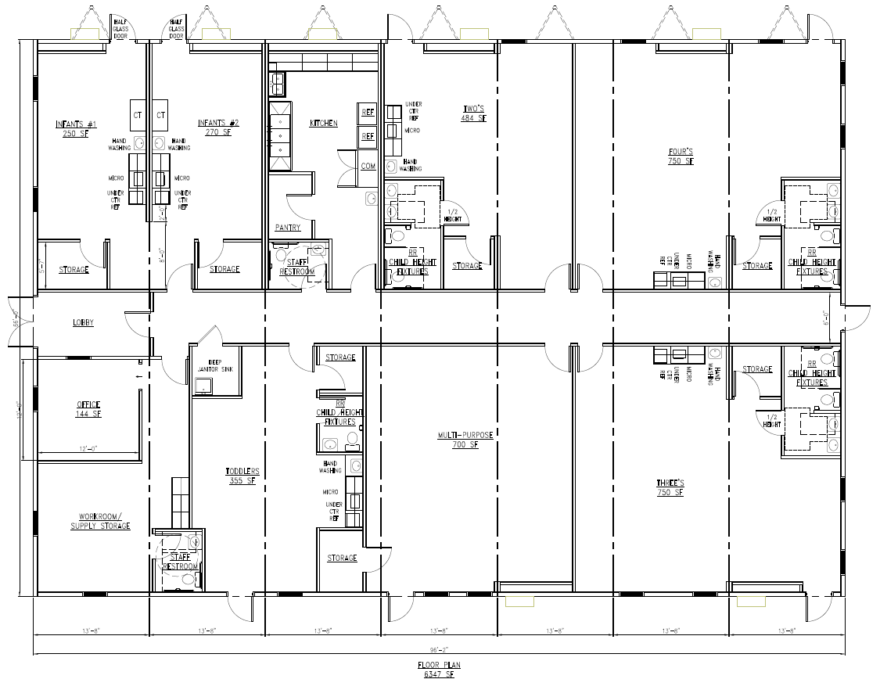
Building Floor Plan

Slide 6

Questions?
Gary Whipple- Deputy Director Department of Public Works & Transportation
Gary.Whipple@stmarysmd.com
Drew Kelly- Project Manger
Drew.Kelly@stmarysmd.com

Slide 7
Full Site Plan

